Slide 1
CHCNAV Mobile Mapping
RS10 Training
STANDARD WORKFLOW
April 2024

Slide 2
1
SYSTEM INTRODUCTION
CONTENTS
2
NOUN INTERPRETATION
3
STANDARD WORKFLOW

Slide 3
Part1
INTRODUCTION

Slide 4
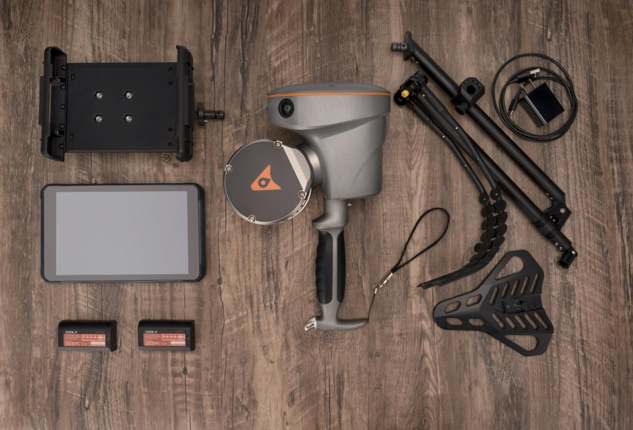
INTRODUCTION
The RS10 surveying system is a new system with deep integration of high-precision RTK and SLAM, which is an innovative product developed by CHC Navigation.
It can obtain high-precision point cloud under various complex environments, and has the ability to collect data of indoor and outdoor scenes. It can be widely used in terrain survey, highway survey, energy facilities, volume survey, old residential renovation, underground spatial information collection and forestry asset management.

Slide 5
Part2
NOUN INTERPRETATION

Slide 6
NOUN INTERPRETATION
SLAM
SLAM is an abbreviation of Simultaneous Localization and Mapping. This technology collects environmental information by using cameras, laser scanner and inertial measurement unit, and uses algorithms to combine these information to determine the location of the device in the environment and build a map.
Point cloud
A collection of points scattered and irregularly distributed in three-dimensional space.
Real time point cloud
It means that the device can acquire, process and visualize the point cloud in real time while collecting the point cloud.

Slide 7
NOUN INTERPRETATION
Loop
The SLAM system corrects accumulated POS errors to improve map consistency and accuracy by detecting loops (i.e. going back to previous locations) and performing closed-loop corrections.
Absolute coordinates
Absolute coordinates are coordinate systems that describe a position with a fixed reference point. In such a system, any position can be uniquely determined by a fixed set of values, which are measured relative to a fixed reference point (usually the origin of the coordinate system), and the coordinates measured under WGS84 coordinate systems mentioned below are absolute coordinates.
Relative coordinates
Relative coordinates are coordinate systems relative to a reference point or frame of reference. It is commonly used to describe the relative position and direction of an object in space. The reference point of the relative coordinate is variable and can be the current location or any specified location.

Slide 8
NOUN INTERPRETATION
Perpendicularity
Perpendicularity refers to the difference between the measured value of the vertical plane and its true value, which is usually reflected in degrees or ratios. The smaller the perpendicularity, the higher the accuracy.

Slide 9
Part3
STANDARD WORKFLOW

Slide 10
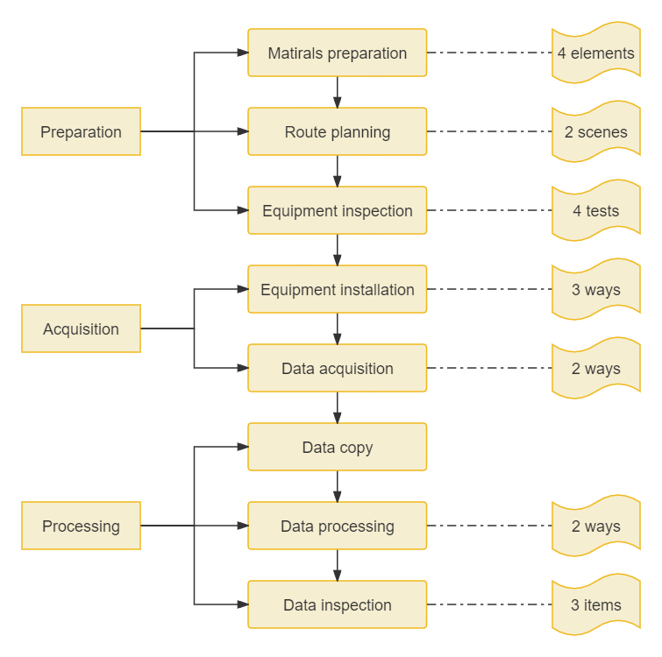
OVERAL WORKFLOW

Slide 11
MATIRALS PREPARATION
(1) Operation scenario and scope Understand project types, such as building facades, tunnel scanning, forestry applications, terrain survey, earthwork survey, etc. Understand the operation scope, for assessing the workload and preparing for the route planning. It is best to provide KML.
(2) Outcome type
Understand the types of results required: point cloud, 2D vectors, earthwork calculations, etc
(3) Control points & checkpoints
Confirm whether there are control points/checkpoints.
Control points will help optimize trajectory and improve accuracy. On the other hand, control points can help transform the point cloud to the target coordinate system.

Slide 12
MATIRALS PREPARATION
(4) Coordinate system
Relative coordinates: no need to prepare additional data, can directly scan data.
Absolute coordinates: There are two ways to obtain absolute coordinates, one is RTK mode, that is, using CORS when collecting; Instead, it is PPK mode, which uses the base station data observed at the same time for post-differential processing.
Coordinate conversion parameters may also be required if the outcome coordinate system required by the project is a local coordinate system.

Slide 13
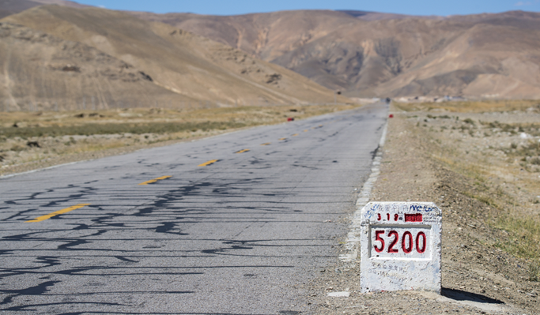
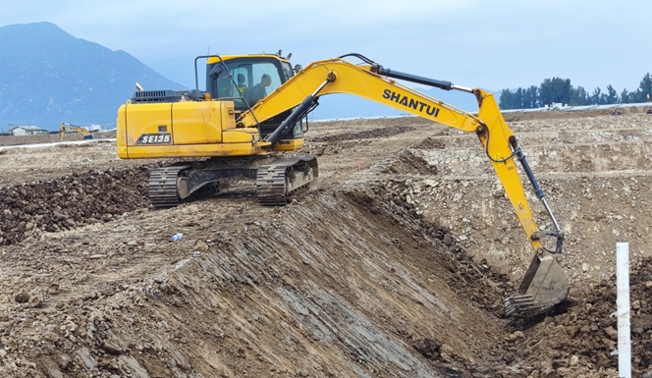
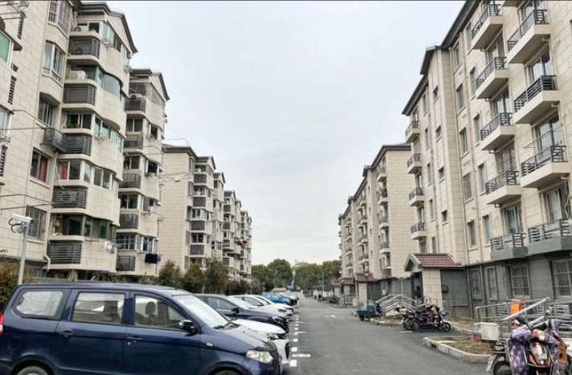
ROUTE PLANNING
(1) Open outdoor scenes
In an outdoor environment with a good GNSS signal (more than 70% of the area has a good signal), the RS10 relies on high-precision RTK positioning to calibrate SLAM position and attitude in real time, without the need for a loop. So path planning is free.
Sales tactics:
(1) RTK data is deeply involved in SLAM data processing, correcting position and attitude in real-time, but SLAM from other competitors, only correct trajectory;
(2) We use high-precision RTK antenna, but other competitors use commercial spiral antenna. CHC Navigation has been doing RTK for more than 20 years, and no product dares to use spiral antenna for complex scene measurement;
(3) In the scenario of bad signal, we are the same as other trajectory, relying on the SLAM algorithm.
Terrain Survey
Road Survey
Capital construction
Residential quarters

Slide 14
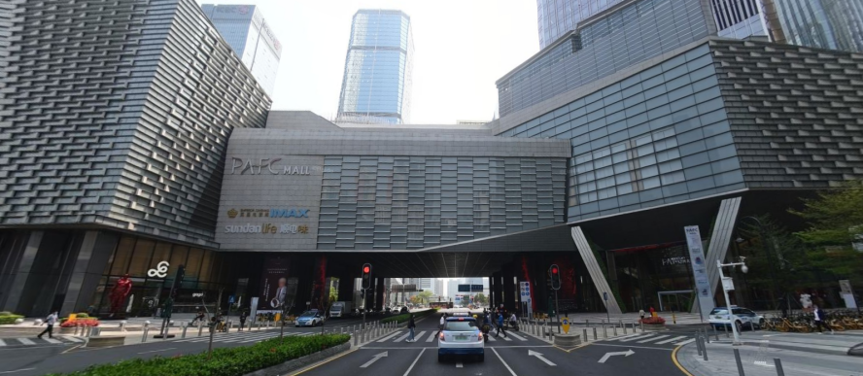
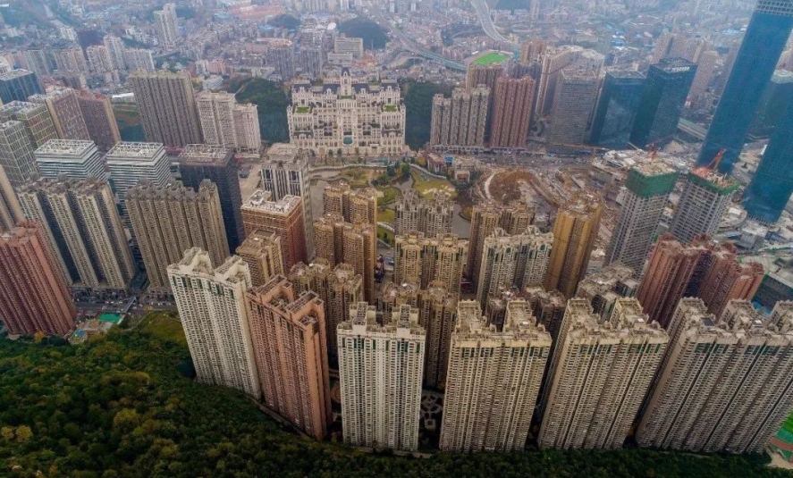
ROUTE PLANNING
(2) Other scenes
In principle, the trajectory does not need to be looped within 300m, and must be looped beyond 300m. The overlap distance of the loop should be greater than 20%, and the trajectory should be as many loops as possible.
When the survey area is large, you can use a few routes to build the overall positioning map. Then scan in detail with small loops, and gradually advance to cover the whole area; When the survey area is small, small loops can be formed continuously for data acquisition, and the whole survey area is gradually scanned.
Sales tactics:
In this type of scenario, the device cannot obtain accurate RTK data, so it must improve the accuracy through the path loop, which is determined by the principle of SLAM technology, and other competitors are also the same.
Underground Parking
Urban Canyon
Forestry
Built-up Area

Slide 15
Equipment Inspection
Check content:
(1) Equipment integrity: list of goods;
(2) Authorization: RS10, Landstar, SmartGo;
(3) Firmware and software version: RS10, Landstar, SmartGo, CoPre;
(4) Equipment power: batteries, tablet.
Sales tactics:
(1) RS10 only needs one packing case to hold all the host and accessories, simple and portable. A full set of equipment including host, chest holder, tablet, batteries and charger. There are 3 batteries. One battery life is 1 h. At the same time RS10 has built-in super capacitor, supporting hot swappable battery, to meet the needs of uninterrupted scanning operations. Do not need to stop project when replacing battaries.
(2) RS10 can upgrade firmware and obtain authoration online via SmartGo. Logs can also be selectively uploaded to the cloud server. Users can not only try the continuous optimization of new functions, but also can get a quick response from CHCNAV when there is an issue.

Slide 16
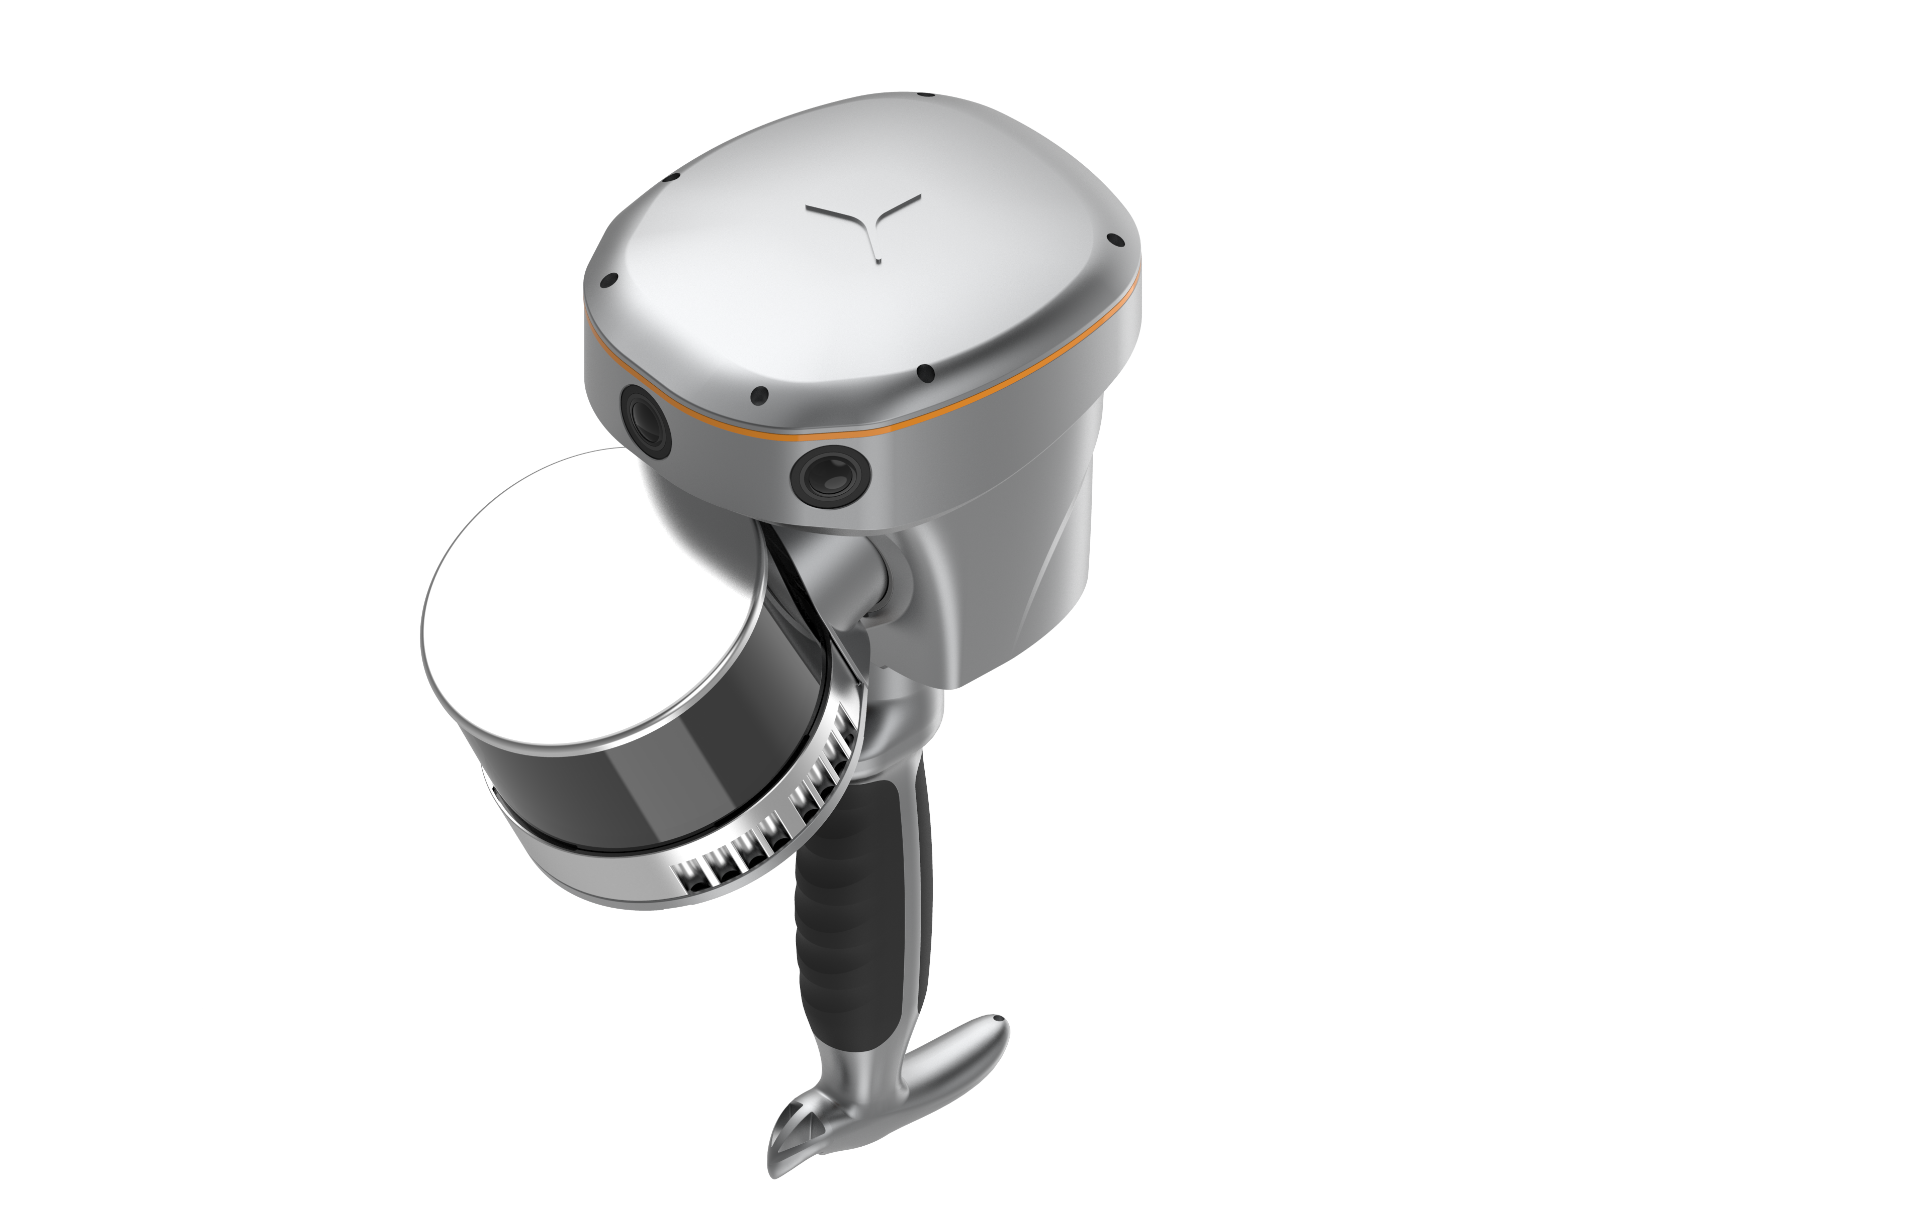
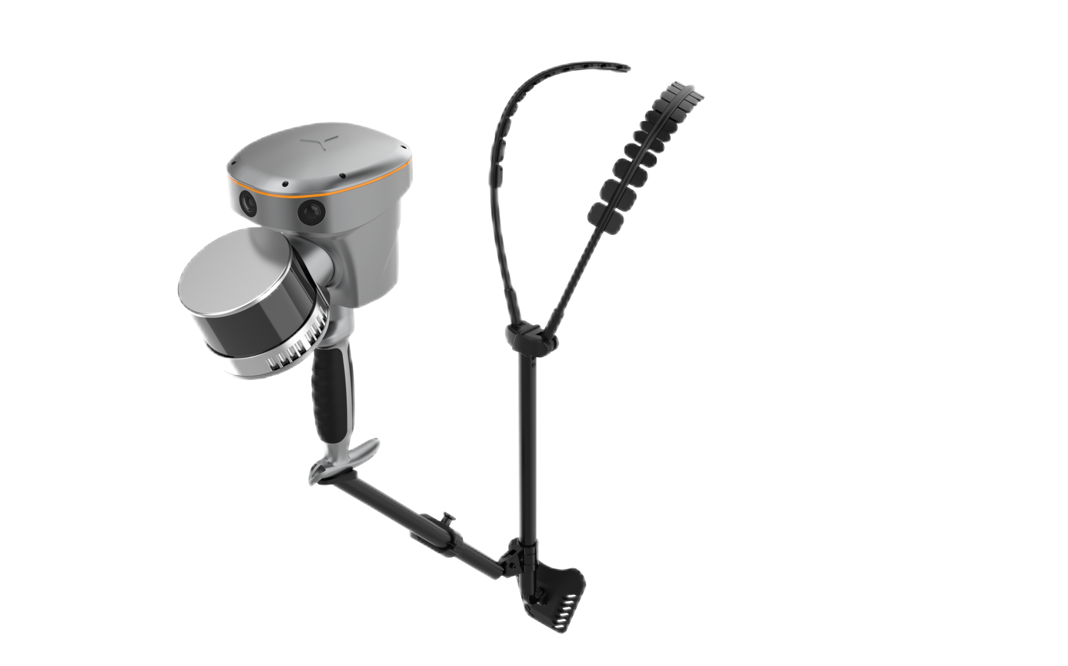
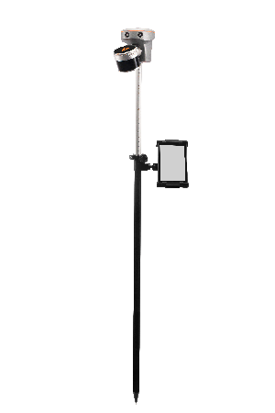
Equipment Installation
Mode | Picture | Recommended scenario | Notes
Handheld |  | Small area operation: convenient and flexible. | When installing the handle, ensure that the handle is locked to the host tightly. Prevent host and handle falling off during scanning.
Chest Holder |  | Long time operation: Chest holder can greatly reduce fatigue, compared to handheld mode | When using the chest holder, keep the host in your hands to prevent it from falling.
Centering Rod |  | Special scene requirements: The centering rod lengthens the hand-held distance to solve the problem of remote points that cannot be collected in handheld mode, such as the top of the tunnel, the blocked wall, and the pipeline, so that the scan is complete. | 1. Do not impact the ground with the centering rod, otherwise it will cause damage to the instrument; 2. Due to the influence of the rotating torque of the laser, it is necessary to pay attention to the intermittent check whether the centering rod is backthreaded and the host is loose during the long-term scanning operation.

Slide 17
Equipment Installation
Sales tactics:
(1) Handheld mode: RS10 weighs only 1.9kg, is the lightest scanner on the market (other products from competitors have a lot of accessories, so the total weight is much heavier than RS10). Handheld mode is suitable for short time operation, convenient and flexible.
(2) Chest holder: When scanning for a long time, we recommend chest holder, which is easier to work and can last several hours of scanning without feeling tired. Compared with the other backpacks on the market, the chest holder has the advantages of light weight and easy control of scanning angle. (Note: If the customer asks about the shelter, discomfort and other problems of the chest holder, we can give an explanation, this is an old version, the new version of the chest support will be updated after May)
(3) Centring rod: This mode is mainly used in some special scenarios, the centring rod lengthens the handheld distance to solve the problem of remote points that cannot be collected in handheld mode, such as the top of the tunnel, the blocked wall, and the pipeline, so that the scan is complete.

Slide 18
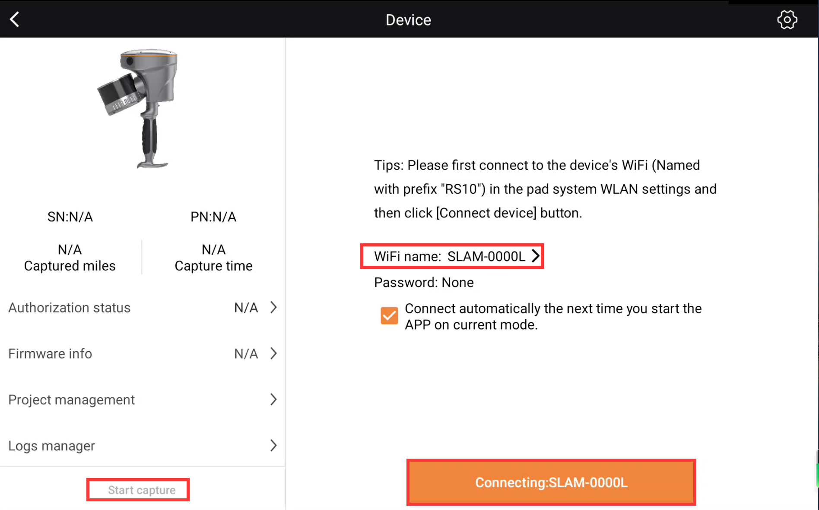
Data Acquisition
The most common scanning method is that RS10 is controlled by SmartGo software.
Step 1: WiFi connection
Open SmartGo, connect to the device via WiFi, then click “Start capture”.
Note: Ensure that no other apps on the tablet connect to the device WIFI to avoid the situation that the device WIFI is occupied;
Sales tactics:
SmartGo software is control software of CHCNAV 3D Mapping, including UAV route planing, vehicle data acquisition, RS10 acquisition, equipment online upgrade and registration, etc. In addition, SmartGo supports uploading log files, which allows our after-sales service team to quickly locate problems and timely solve the problems users encountered.

Slide 19
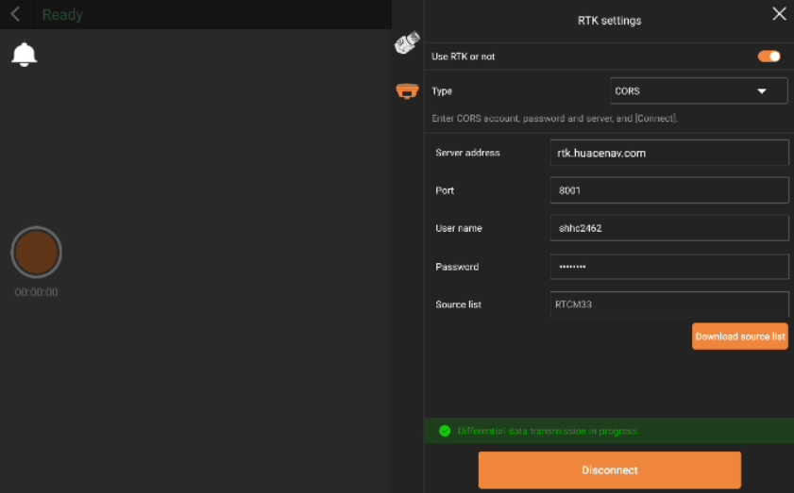
Data Acquisition
Step 2: RTK settings (optional)
You can obtain real-time point cloud data with absolute coordinates by logging into the CORS account in the RTK settings.
Note: Avoid account occupation and disconnection caused by multiple devices logging in with the same account.
Sales tactics:
The advantage of using CORS is that in the case of good signal, RS10 can directly output real-time point cloud under WGS84 coordinate system, unify coordinate system of indoor and outdoor data , and also correct SLAM position and attitude based on RTK high-precision positioning results to improve the accuracy of results.
If you do not use CORS, you can also obtain the point cloud results with absolute coordinates in CoPre through PPK post-processing or trajectory control point optimization.

Slide 20
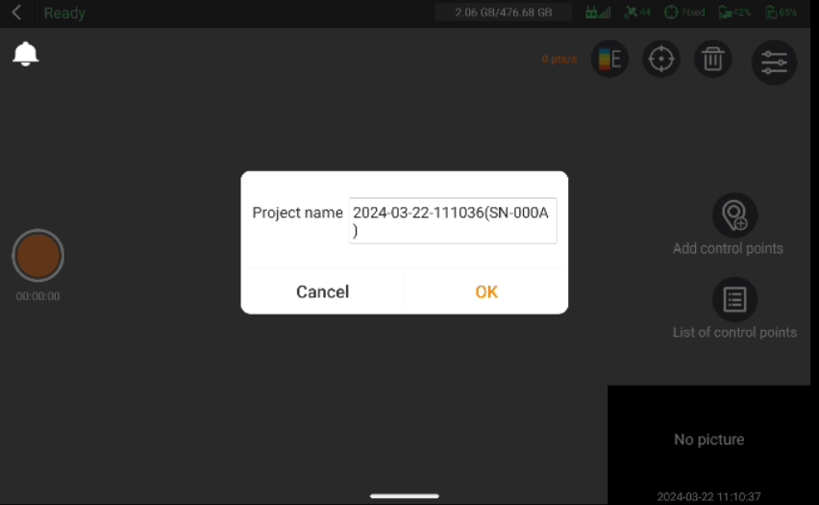
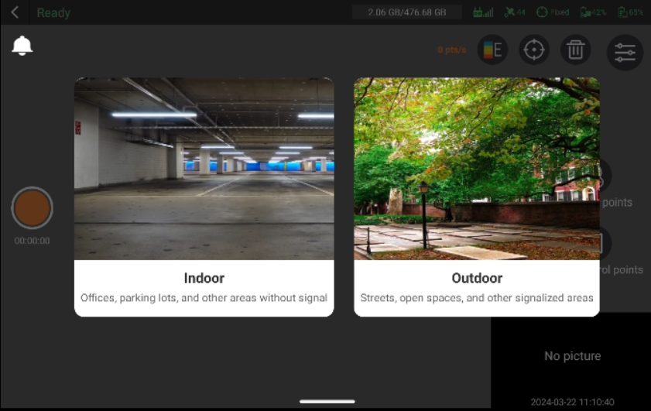
Data Acquisition
Step 3: Start project
Click on the orange circular button on the left side of the screen to start a project. After creating the project, select the appropriate capture scene based on the environment, and proceed to data collection within the chosen scene.
Sales tactics:
(1) Custom project name, easy data management;
(2) There are corresponding algorithms for different scenarios to ensure reliable data accuracy.

Slide 21
Data Acquisition
Step 4: Device initialization and data aquisition
Initialization starts automatically after selecting capture scene , please keep the device stable and ensure no obstructions around. After the initialization is successful, the device will enter the capture interface, where real-time point cloud and live captured images will appear, which means the device has started data collection automatically.
Notes:
(1) Ensure that the device is oriented towards feature-rich scenes, such as houses, irregular objects;
(2) Ensure that there is no shelter;
(3) Minimize the scanning of high-reflectivity objects, such as glass, otherwise there will be some noises in point cloud.
Sales tactics:
(1) No need to put RS10 on the ground, no need to wait for a long time, keep still for 2 sec to pass the initialization;
(2) After initialization, real-time point cloud can be displayed on the tablet based on the built-in 1.2T computing power processor, and the scanning area can be viewed in real time through point cloud to avoid data loss;
(3) Real-time point cloud results can be directly copied and used. What you see is what you get;
(4) Real-time point cloud supports a variety of rendering methods.

Slide 22
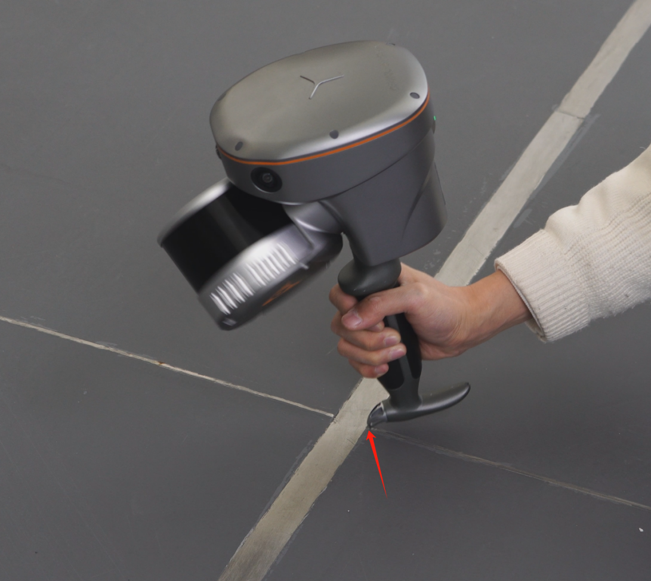
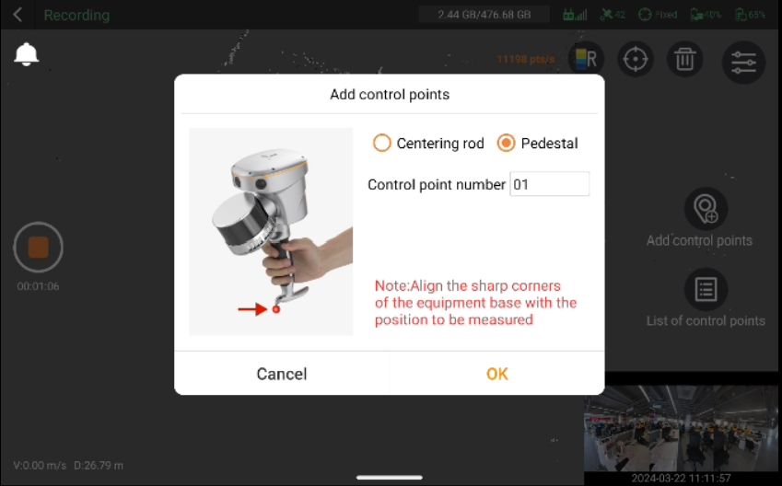
Data Acquisition
Step 5: Add control points (optional)
Control points will help optimize trajectory and improve accuracy. On the other hand, control points can help transform the point cloud to the target coordinate system.
You can add some control points during the data collection. First, align the metal tip of the device's handle with the desired control point. Then click "Add control Points" , select the corresponding operation mode, input the control point number, and click "OK" to add the control point.

Slide 23
Data Acquisition
Step 5: Add control points (optional)
Notes:
(1) The name of the control points should be consistent with the name of the provided control points;
(2) For coordinate conversion, at least 4 control points are required.
(3) When collecting control points with a centering rod, you need to enter the rod height.
Sales tactics:
(1) When absolute coordinate results are needed, the RS10 trajectory control points can be collected by placing the metal tip of the handle on the control points and cooperating with SmartGo one-click collection. The precision optimization and coordinate conversion can be completed by one-click matching in CoPre;
(2) It also supports collecting control points by centering rod. In some special scenarios where hand-held collection is inconvenient or inaccessible, centering rod is helpful. For example, when the control points at the top of tunnels and mines, it can use the centering rod to collect by inverting the equipment, perfectly solving the problem of difficult collection of control points in special scenarios.

Slide 24
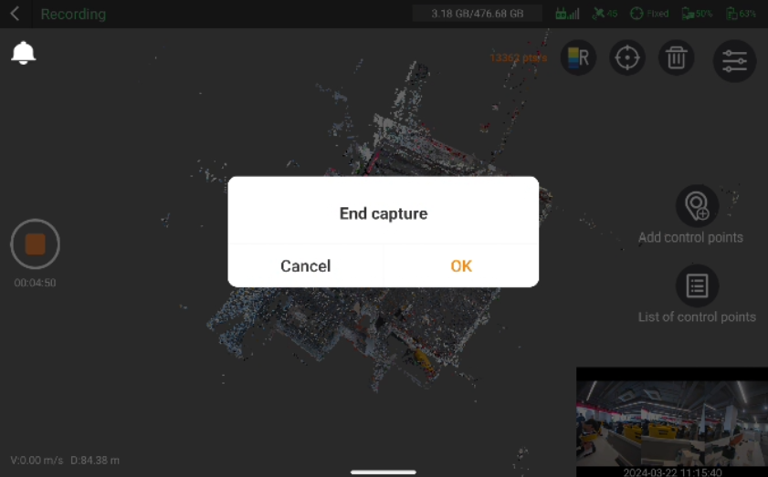
Data Acquisition
Step 6: End capture
Click on the orange circular button on the left side of the screen to stop data acquisition.
Sales tactics:
Fast closure without waiting.

Slide 25
Data Acquisition
The RS10 is embedded with one-key acquisition software, equipped with one button (including a LED indicator), the RS10 can be controlled by a single key to complete data collection.
Status | Operation | Indicator light
Power on | Long press “ON/OFF key” for 5s | Green light steady on
Device diagnostics | 5s after powering on, the device enters diagnostic mode aumatically | Under diagnosis:Green light flashing rapidly at 2Hz Diagnosis complete:Green light steady on
Start project | Short press “ON/OFF key” | Green light steady on
Device initialization | keep the device stable for 2 sec and ensure he device is oriented towards feature-rich scenes | Laser rotates
Start capturing | After the initialization is successful, the device will start data collection automatically | Green light flashing slowly at 0.5Hz
Stop capturing | Short press “ON/OFF key” | Green light steady on
Power off | Long press “ON/OFF key” for 5s | Light off

Slide 26
Data Acquisition
The RS10 is embedded with one-key acquisition software, equipped with one button (including a LED indicator), the RS10 can be controlled by a single key to complete data collection.
Notes:
(1) One-key acquisition cannot log in to CORS, and cannot output real-time point cloud with absolute coordinates;
(2) During the collection, the tablet can also be connected to control the device and browse the real-time point cloud. Otherwise, there is no way to see the real-time point cloud.
Sales tactics:
One-key collection meets emergency usage requirements. In other cases, you are advised to use SmartGo to use more functions.

Slide 27
Data Acquisition
Matters needing attention:
(1) RS10 is a precision measuring equipment, it is prohibited to bump to prevent equipment damage;
(2) When collecting data, do not impact the centering rod on the ground to prevent equipment damage.
(3) Avoid large and rapid steering jitter, which will cause the problem that the front and back frames of SLAM algorithm cannot be matched, resulting in data unsolvable and real-time point cloud confusion;
(4) When collecting data, keep the distance of the equipment from the target above 0.5m;
(5) When collecting data, keep the equipment stable, reduce the tilt of the equipment for a long time, and avoid the noise formed on the operator's feet;
(6) When collecting data, it is recommended to scan towards the objects to be measured, especially when it applied to facade or single building projects;
(7) When collecting data, try to avoid fast moving people or objects to reduce noise in point cloud. For example, when a car or a group of people towards the device, the device can be turned to anthor direction;
(8) The standard acquisition speed is 3~5 km/h, the point density is guaranteed to be about 10,000pts/m² (before thickness optimization), and the speed cannot exceed 10 km/h;
(9) In the narrow channel scene surveying, it is necessary to avoid occlusions on the front and side of RS10. In the turn and U-turn, it is necessary to proceed slowly and ensure no occlusions, because there are few features in the narrow environment, occlusions and fast turning will cause the failure of feature point matching and processing.

Slide 28
Data Acquisition
Matters needing attention:
(10) In order to ensure accuracy, it is necessary to replace the battery in the scene with few dynamic objects and rich features. Otherwise, data quality cannot be guaranteed.
(11) RS10 can be connected to external charging bank power supply through TYPE-C port. It should be noted that when using the charging bank power supply, the device must ensure that there is a battery with electricity. External charging bank specifications: 1. Support PD protocol; 2, output voltage 12 V or current 2A above;
(12) During hot swap, keep the device still throughout the whole process. After replacing the battery, click "Replacement completed" (keep the scanner still during the period) after seeing the refresh of the real-time point cloud, and then continue the operation;

Slide 29
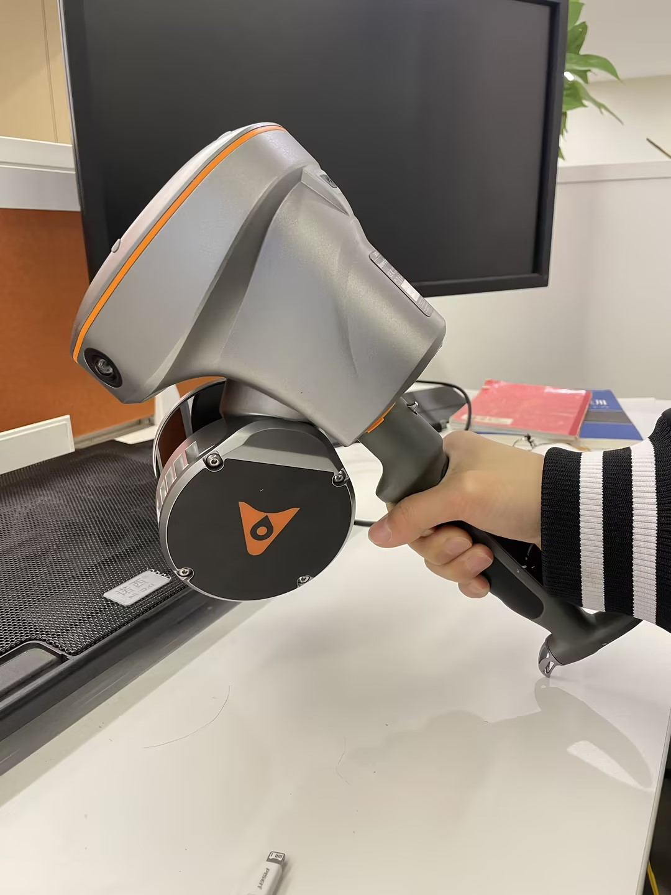
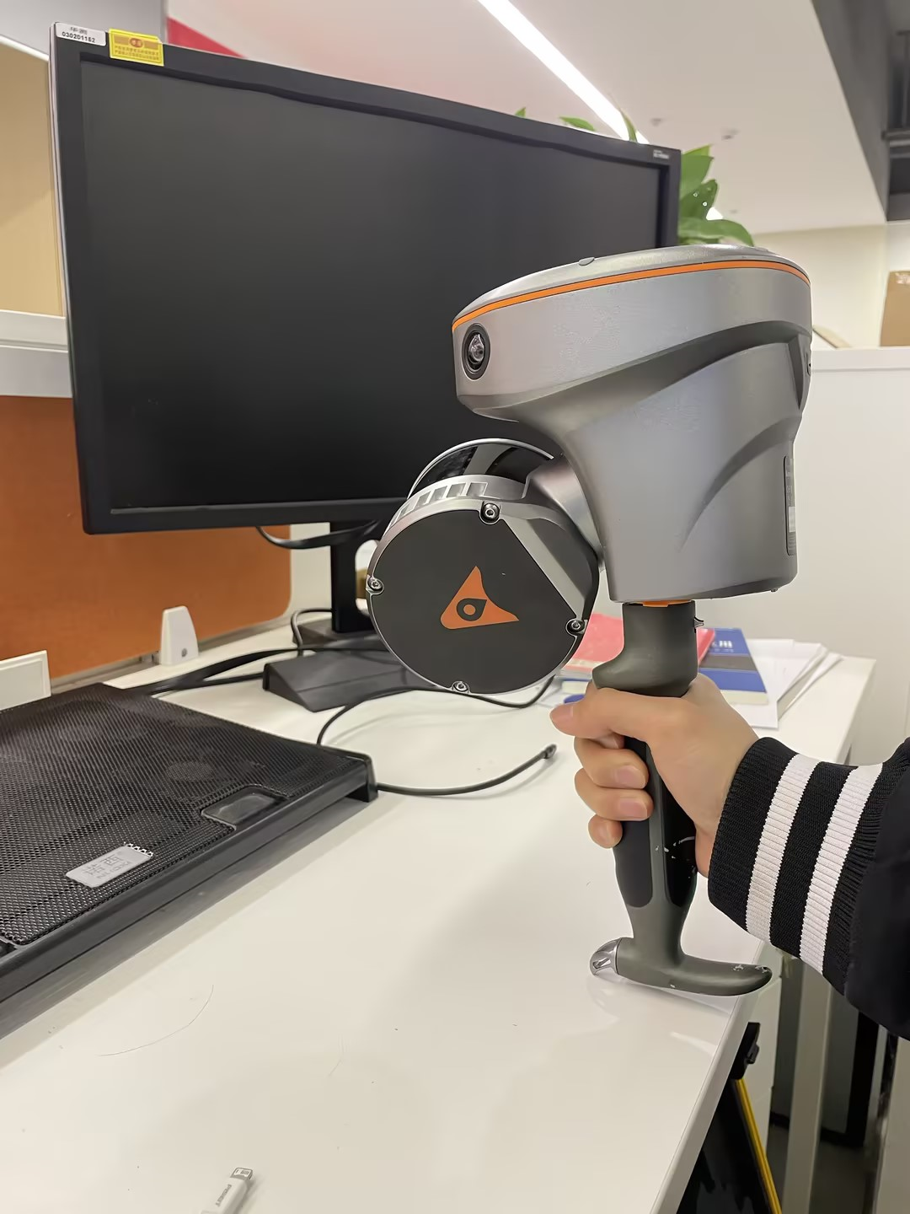
Data Acquisition
Matters needing attention:
(13) When using the handle mode to collect control points, pay attention to slow movements when squatting and rising to avoid large and fast shaking of the device; When collecting the trajectory control point, do not hold the laser against the ground, and do not shield it.
× Wrong example
√ Correct example

Slide 30
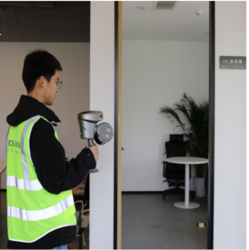
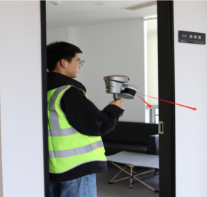
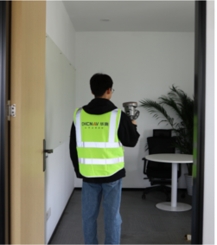
Data Acquisition
Matters needing attention:
(14) When scenario switching occurs, ensure that the public areas are covered.
Enter the door
Correct example: Enter the door sideways to ensure that there is a common scanning area before and after entering the door, which is convenient for data matching
Before entering the door | Entering the door | After entering the door

Slide 31
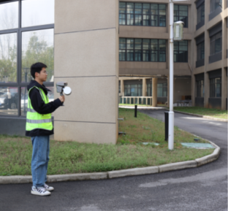
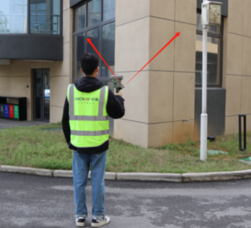
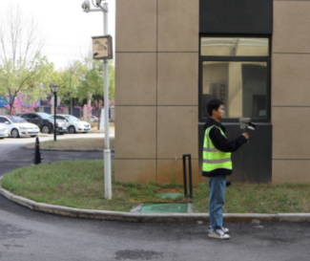
Data Acquisition
Matters needing attention:
(14) When scenario switching occurs, ensure that the public areas are covered.
Turn a coner
Correct example: When turning, turn the laser to the wall to ensure that the laser can scan both sides at the same time,which is convenient for data matching
Before turning | Turning | After turning

Slide 32
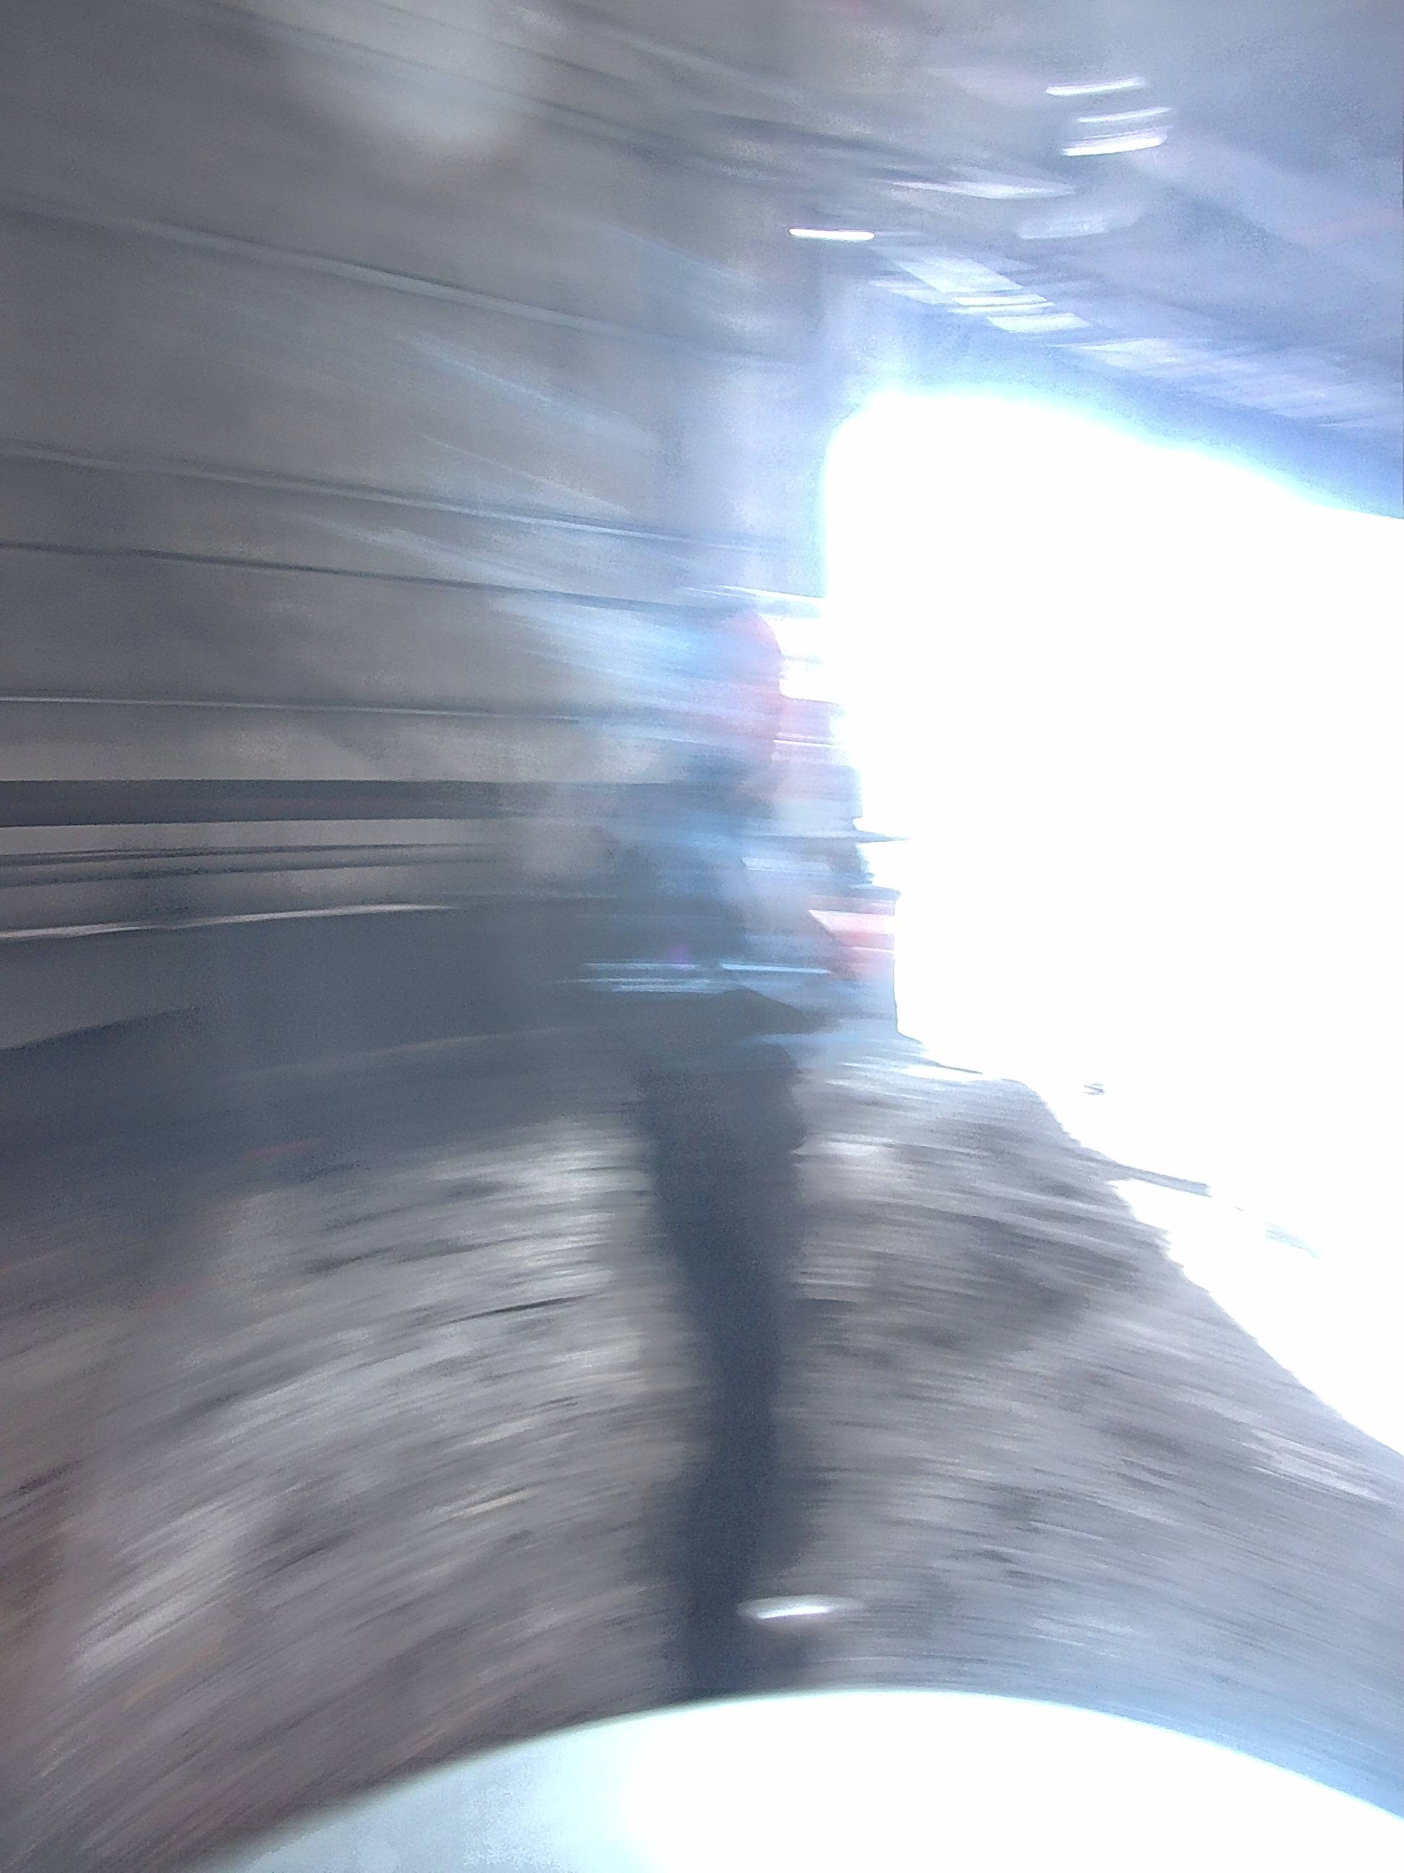
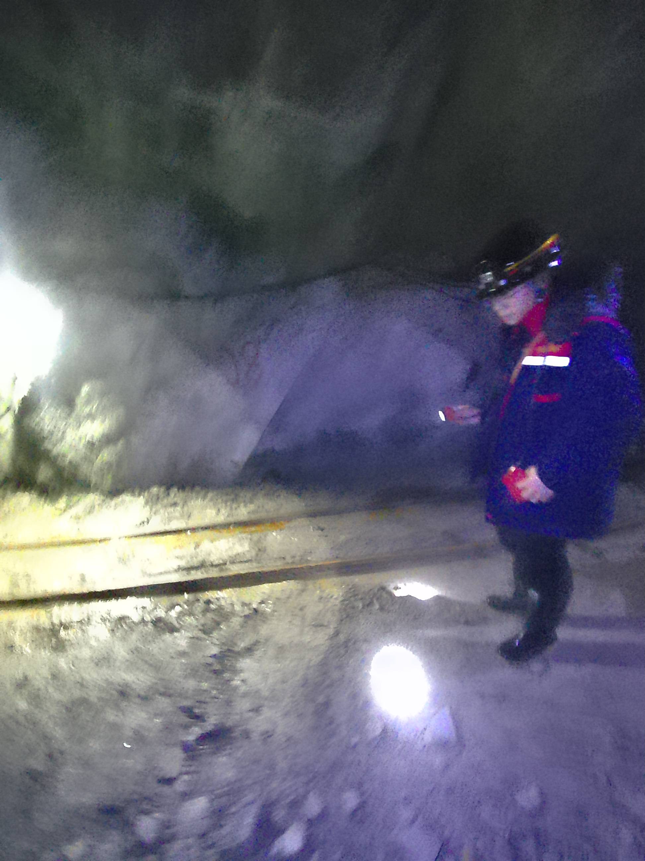
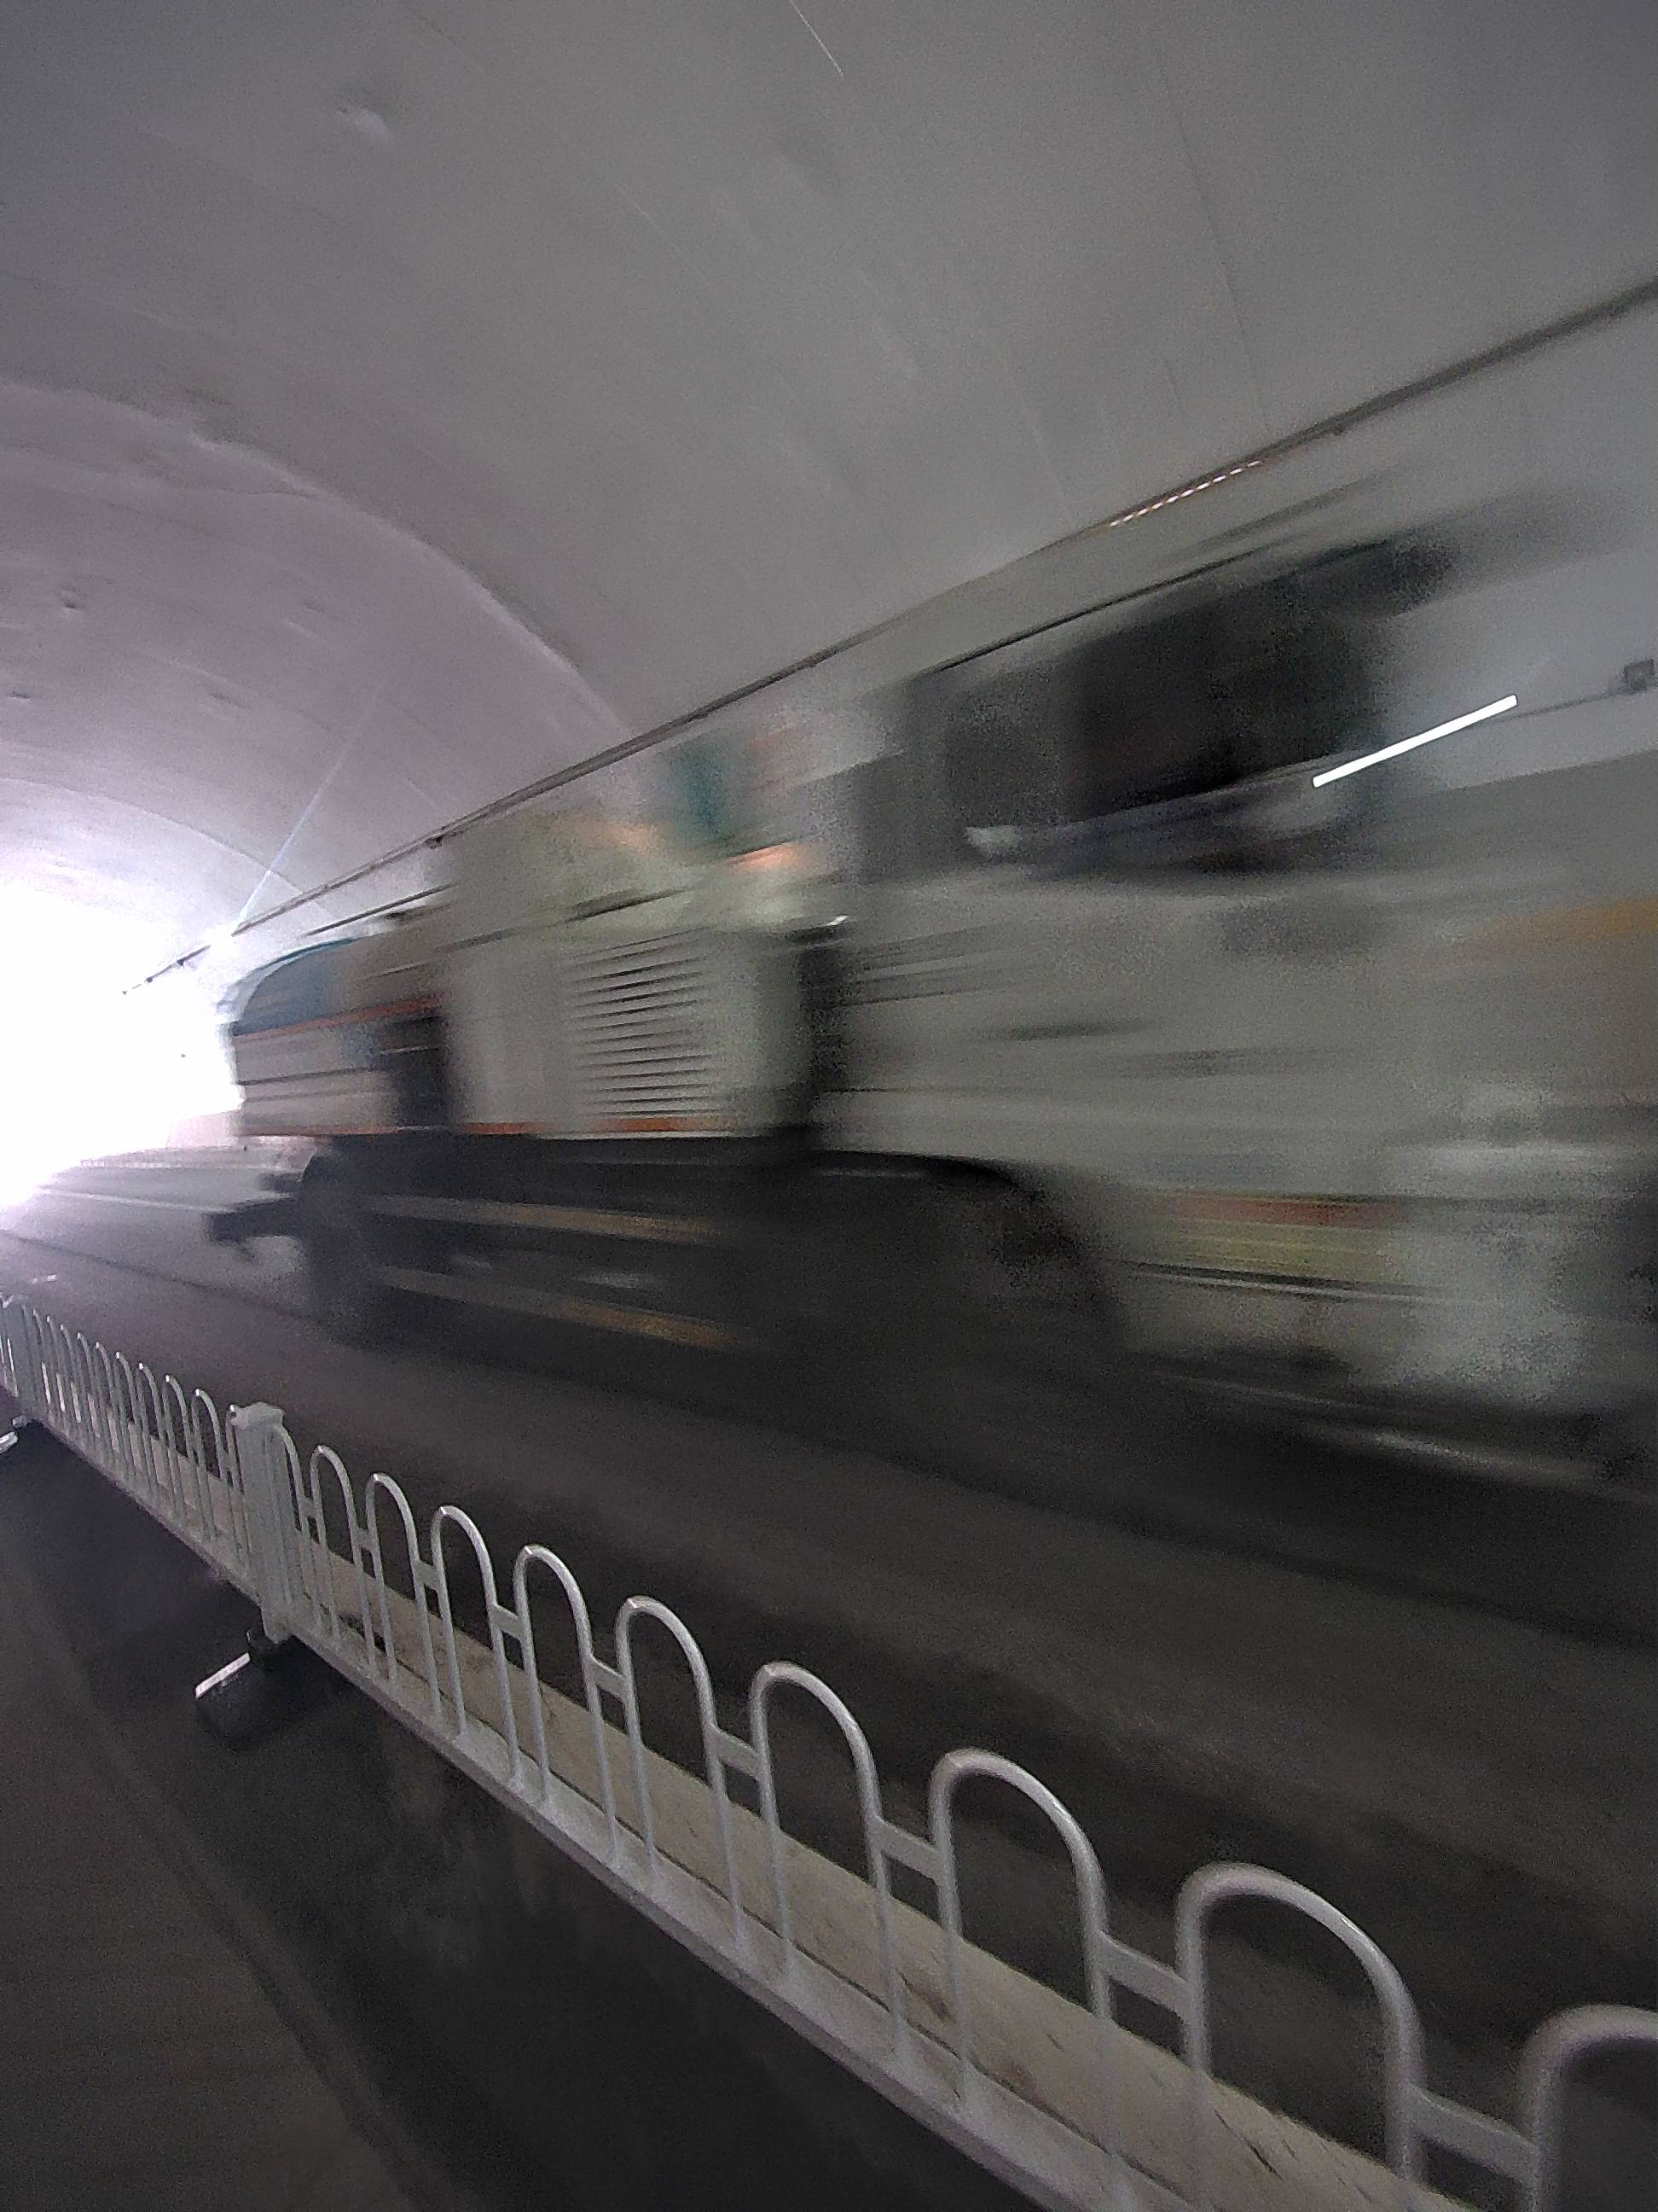
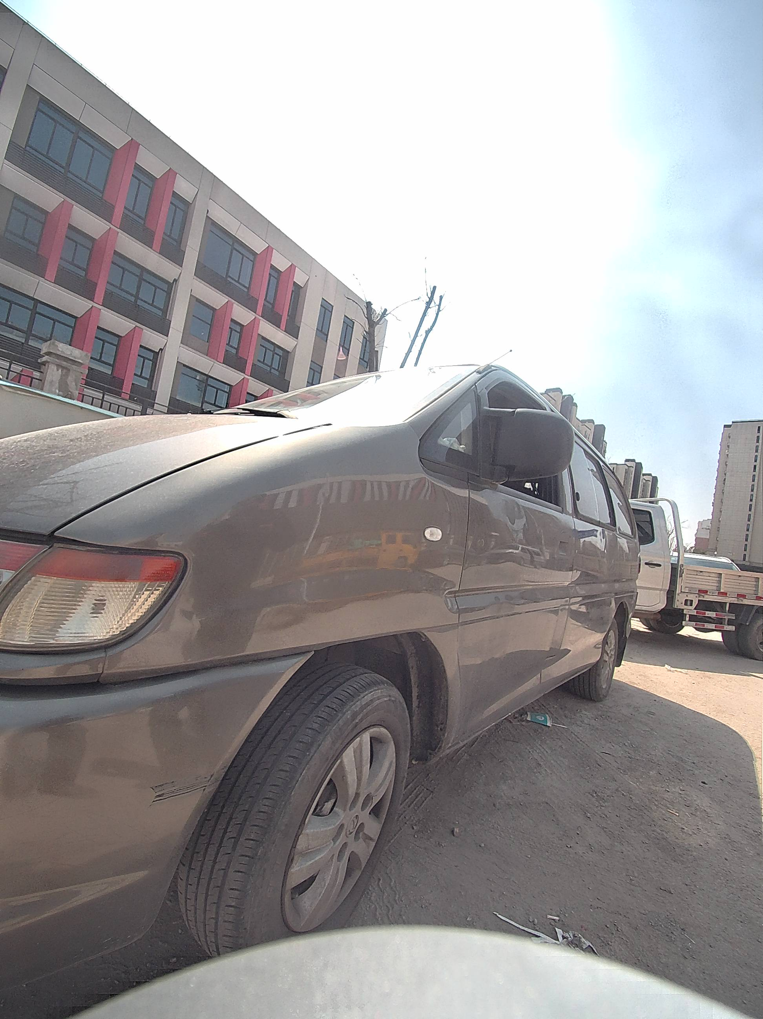
Data Acquisition
Matters needing attention:
× some wrong examples
Device fast shaking
Scanning moving people
Scanning moving cars
Too close to the object

Slide 33
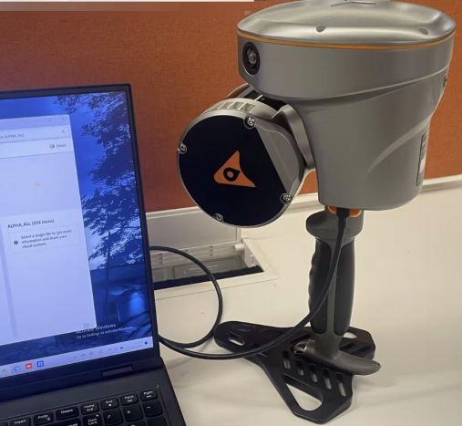
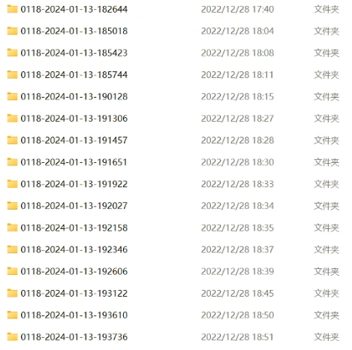
Data Processing
Step 1: Data copying
Power off the device, connect the device to the computer via TYPE-C cable, then copy the data to the specified location.
Sales tactics:
It is convenient and efficient to copy data, and it only takes 5 minutes to copy the data collecting for 1 hour. Data integrity is automatically checked during the copy process; The project data and real-time point cloud data are copied together, and the real-time point cloud can be directly loaded and used.

Slide 34
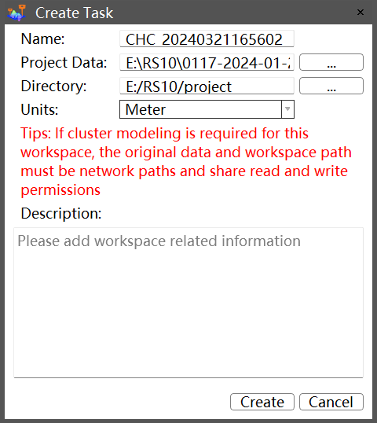
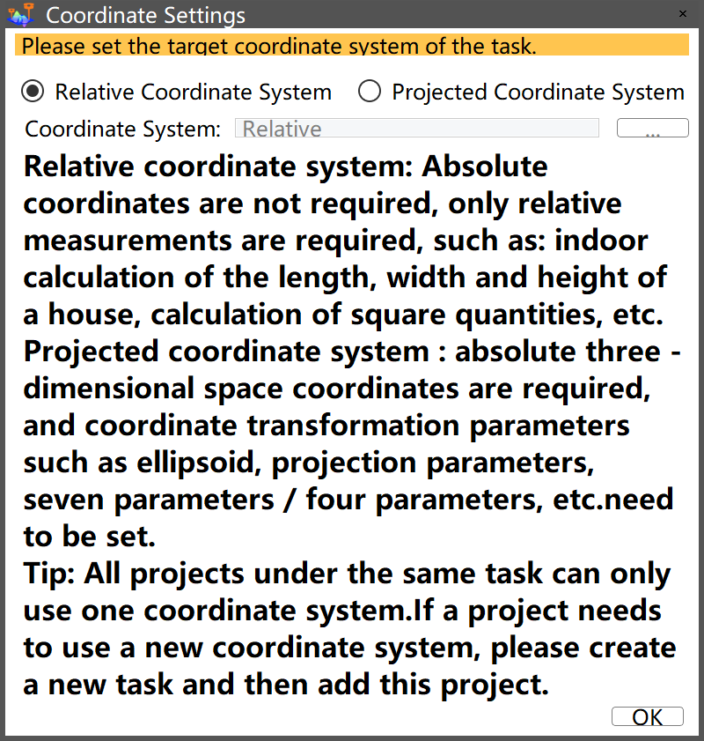
Data Processing
Step 2: Create task and set coordinate system
Open CoPre software, Click Home -> Create, pop up the dialog box to create a task. After clicking “Create” , a coordinate settings window will pop up, you can choose relative coordinate system or projected coordinate system .
Sales tactics:
It can directly output the result data of the target coordinate system without the need for subsequent complex coordinate conversion.

Slide 35
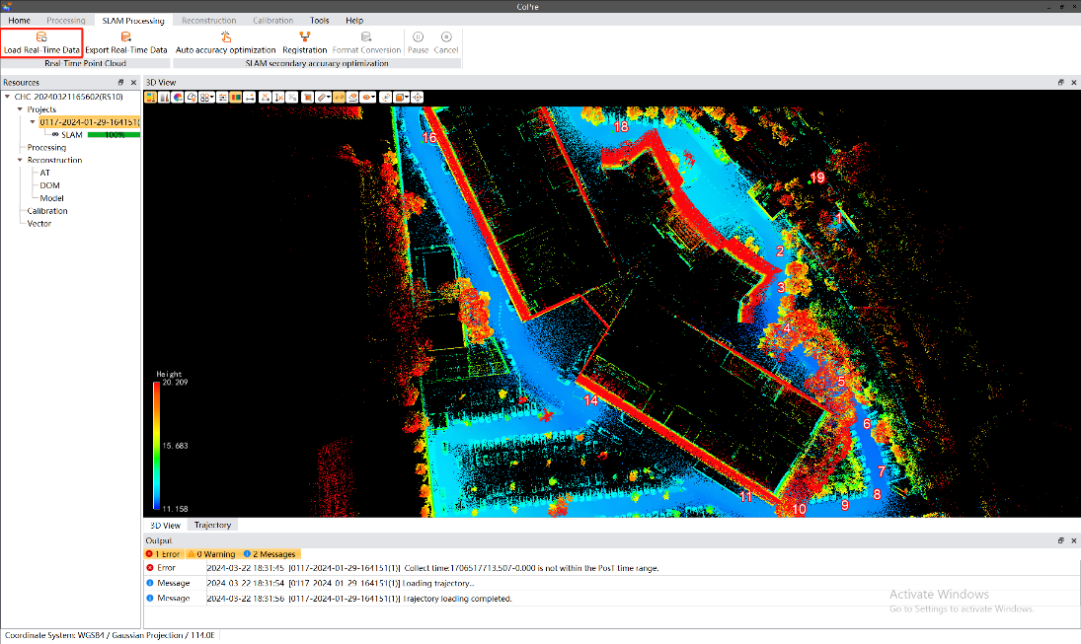
Data Processing
Step 3: Load real-time point cloud
In CoPre's SLAM processing module, click on 'Load Real-Time Data' , it will generate and display real-time point cloud results. To export real-time point cloud data in LAS format, click on 'Export Real-Time Data'.
Sales tactics:
The real-time point cloud can be viewed through CoPre one-click loading, which can not only measure it, but also support accuracy check and output accuracy report.

Slide 36
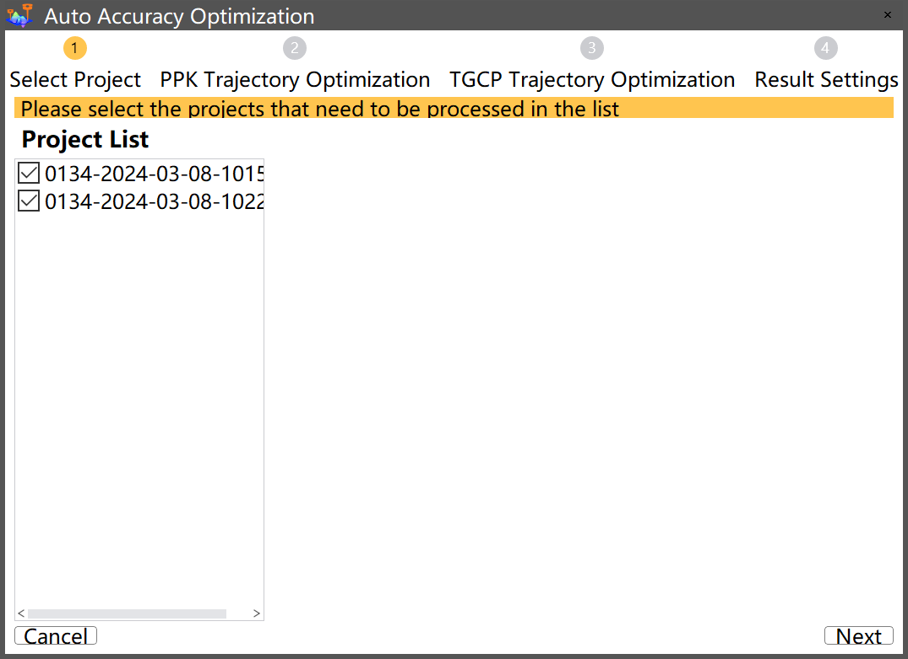
Data Processing
Step 4: Accuracy optimization
Click “Auto Accuracy Optimization” , pop up the dialog box to select proects that need to be processed in the list.

Slide 37
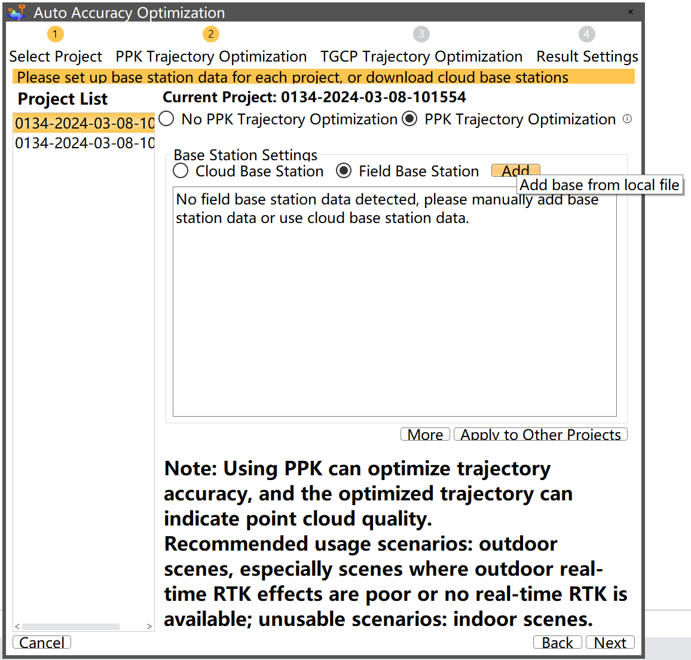
Data Processing
Step 4: Accuracy optimization
Click “next” to set PPK trajectory optimization parameters. When the device works in a more open scene and has base station data, it can choose to use PPK trajectory optimization; When the GNSS signal of the device is poor or no GNSS signal, and static data cannot be obtained, PPK trajectory optimization can not be used.

Slide 38
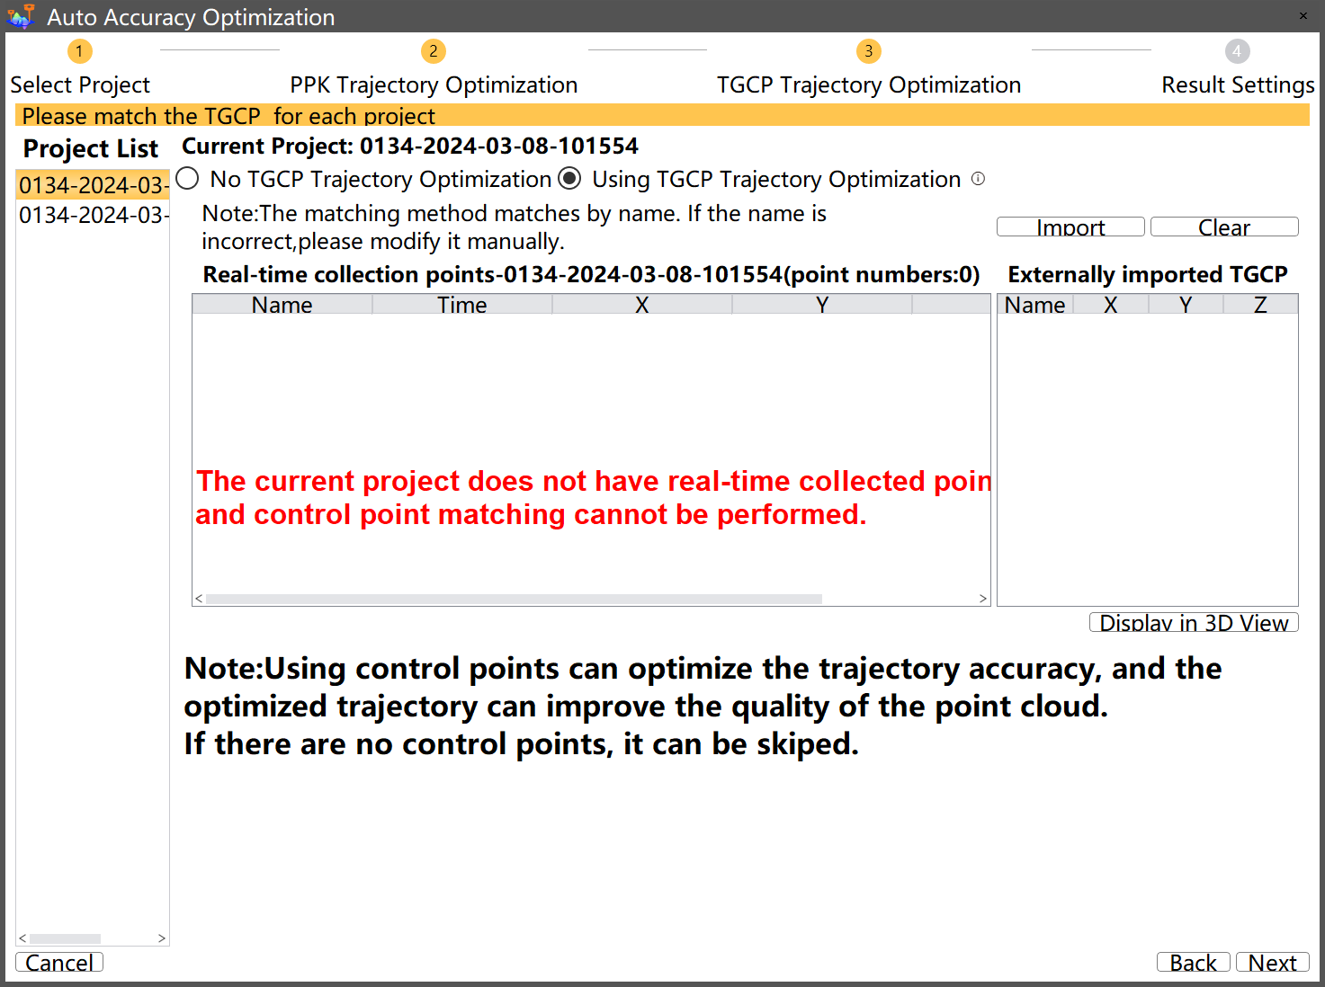
Data Processing
Step 4: Accuracy optimization
Click “next” to set TGCP trajectory optimization parameters:
Use trajectory control points to correct the accuracy of SLAM and transform the point cloud from a relative coordinate system to a projected coordinate system. This function can only be used if trajectory control points are collected during data acquisition. Click on "Import" to import the control point file in txt or csv format. The control points will be matched with the trajectory control points collected in the field based on their names.

Slide 39
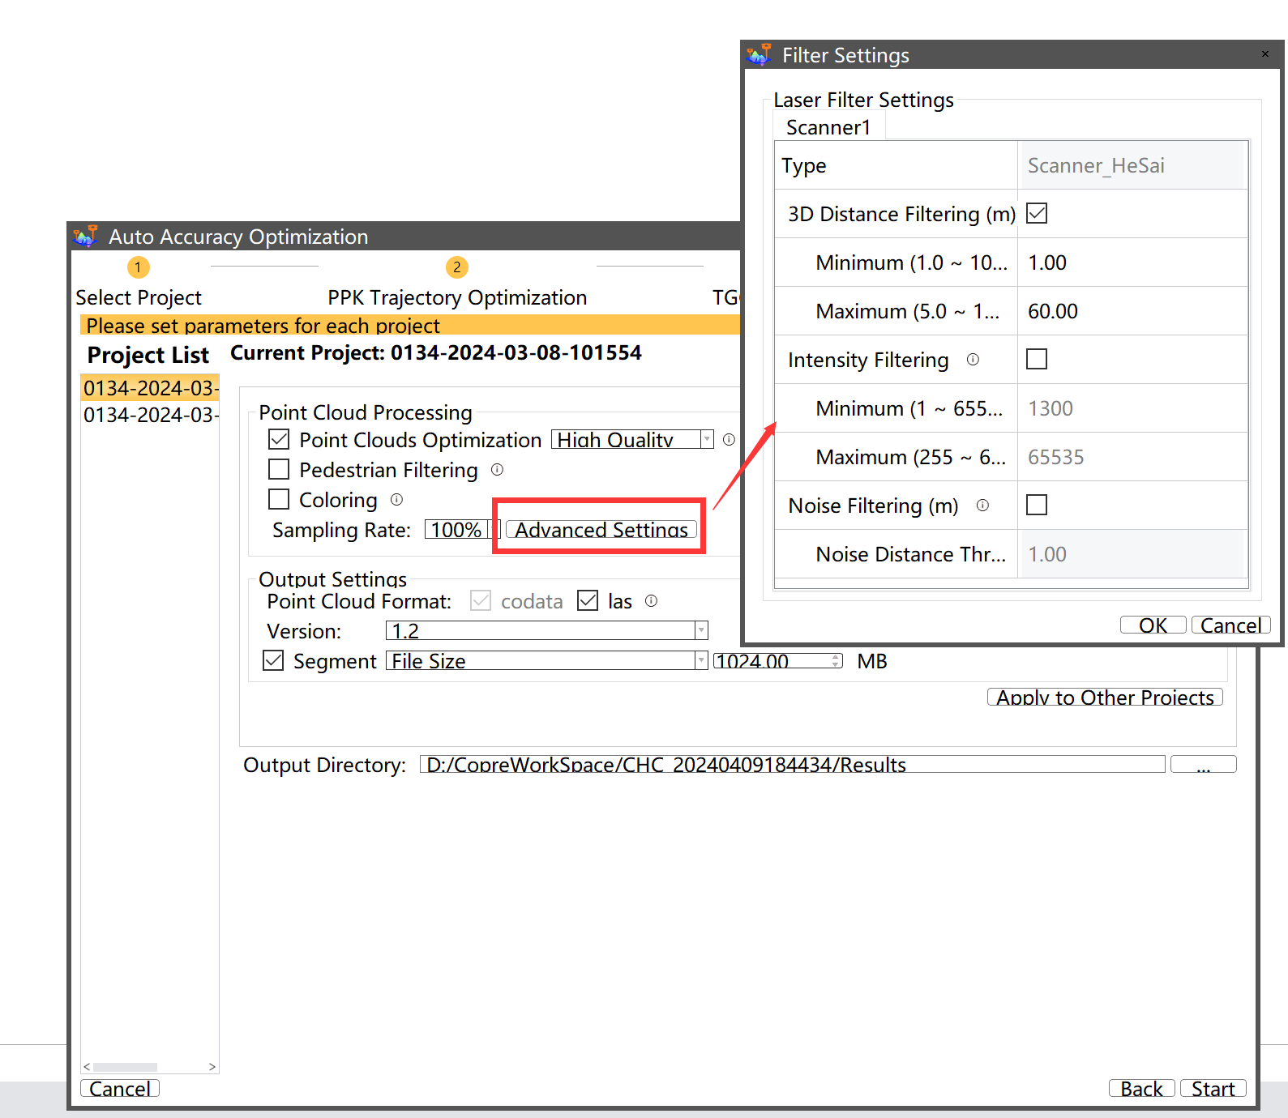
Data Processing
Step 4: Accuracy optimization
Click “next” to set result parameters:
Point cloud optimization: Reduce the thickness of the point cloud to make the local structure finer
Pedestrain filering: Filter noise caused by pedestrians and moving objects
Coloring
Sample rate
Output format
segment mode
...

Slide 40
Data Processing
Step 4: Accuracy optimization
Sales tactics:
(1) According to the accuracy optimization wizard, easy to operate;
(2) If the collection is performed indoors, the device does not have GNSS data, and PPK processing cannot be performed. You can skip this step directly. But how do we get absolute coordinates without PPK? Our trajectory control points can also convert the point cloud from relative coordinates to absolute coordinates, and constrain SLAM trajectories to improve accuracy.
(3) The trajectory control points added to SmartGo are automatically recorded in the project data, we only need to import the trajectory control point coordinates into CoPre. The name of the imported control points must be consistent with the name of the field control points, and the software can automatically match them.
(4) CoPre can optimize the thickness of the point cloud data of RS10. After optimization, the thickness of the point cloud is less than 2 cm, which can meet the projects with high accuracy requirements such as facade suvey. At the same time, CoPre supports automatic filtering of noise generated by moving objects in the scanning process.
(5) Multiple projects can be solved at the same time, without duty.

Slide 41
Data Processing
Step 5: Result check
Check items |  | Check method
Overall situation | Integrity | 3D view
 | Distortion | 3D view
 | Noises | 3D view
 | Coloration | 3D view
 | Intensity | Point information
 | Density | Density mesurement
Relative accuracy | Misalignment | Vertical slice
 | Perpendicularity | Vertical slice
Absolute accuracy | Plane and elevation errors | GCP check

Slide 42
Data Processing
Step 5: Result check
Notes:
(1) When checking the relative accuracy of the point cloud, it is necessary to check the whole area to ensure the overall point cloud effect;
(2) When checking absolute accuracy, it is necessary to import the feature control points, and the coordinate system of control points must be consistent with the task coordinate settings.
Sales tactics:
(1) After the completion of data processing, point cloud accuracy check is essential. No need to switch software, CoPre software also supports point cloud browsing, measurement, crop and other basic functions; It can also slice the point cloud to check the relative accuracy, and import the control point to check the absolute accuracy.

Slide 43
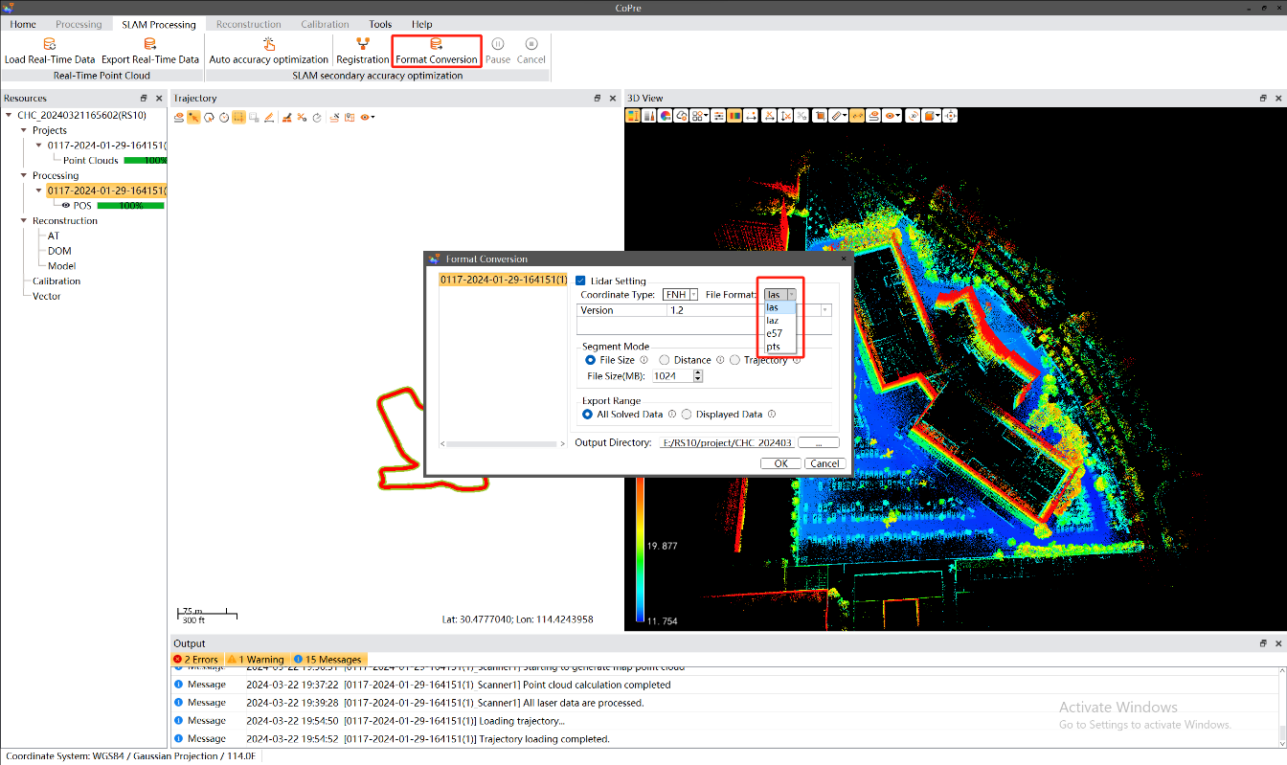
Data Processing
Step 6: Format coversion (optional)
Accuracy optimization will generate point cloud in codata and las format, if you need point cloud in other formats, such as *.pts, *.e57, click on "Format Conversion" to select the format for conversion.

